Slide 1
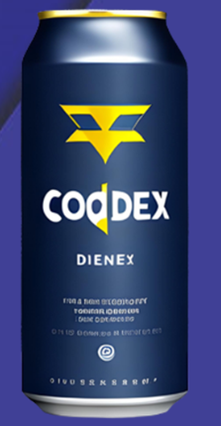

CodeX's Dynamic Marketing Strategy for India
Sahil Rustagi
Presented By

Slide 2

INTRODUCTION
TASK
INSIGHTS & RECOMMENDATIONS
SUGGESTIONS

Slide 3
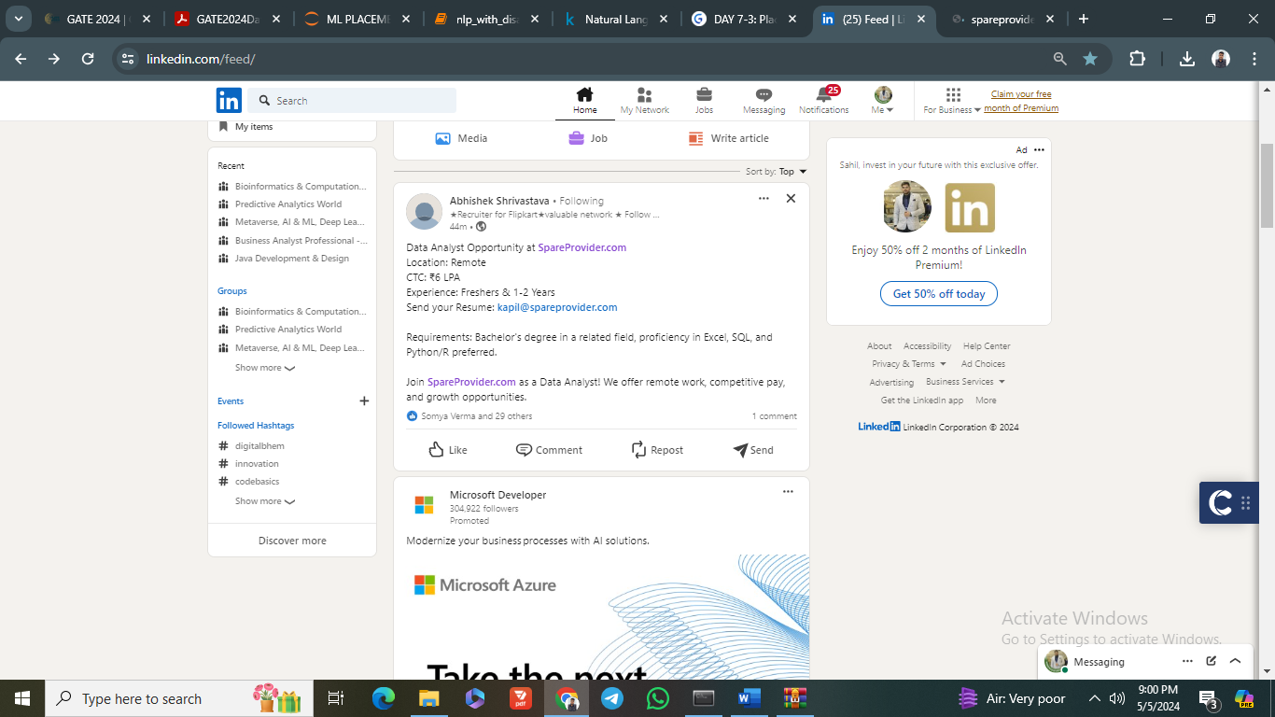

Slide 4

CodeX, a German beverage company, recently launched its energy drink in 10 cities in India. The Marketing team aims to increase brand awareness, market share, and product development. They conducted a survey with different respondents in these cities.

Slide 5


TASK
Analyzing survey responses and providing actionable recommendations for CodeX’s Chief Marketing Officer.

Slide 6
MAIN GOALS
INCREASE BRAND AWARENESS
PRECISE TARGETING OF CONSUMERS
ELEVATING THE MARKET SHARE
PRODUCT DEVELOPMENT
INCREASE BRAND AWARENESS
RECOMMENDATIONS

Slide 7

ANALYSIS OF ALL THE DATA GIVEN BY CONSUMERS ON DIFFERENT FACTORS SUCH AS :
Current Brands
Ingredients etc
Age Groups
Preferences
Mode of Buying
Product type choice
Taste
This Photo by Unknown Author is licensed under CC BY

Slide 8
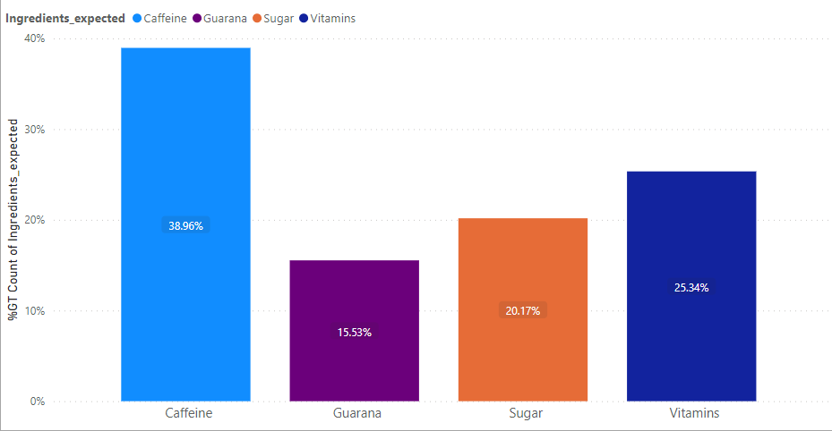
ANALYSIS OF VARIABLES
Caffeine is the most preferred ingredient of energy drink preferred by respondents followed by other ingredients.

Slide 9
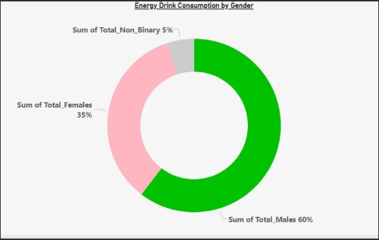
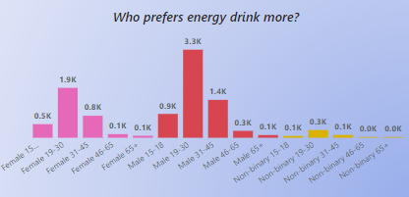

60% of customers are male ,35% females and rest others
19-30 Age group are accounted for the maximum of total energy drink consumption among different age groups

Slide 10
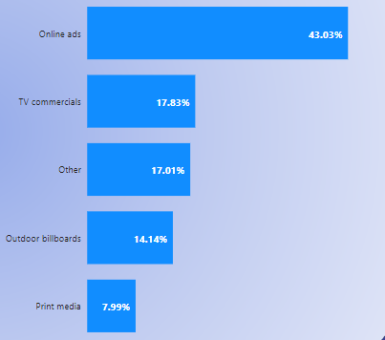
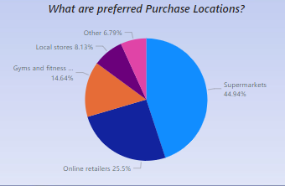
Online ads marketing channels account for nearly half of CodeX’s customer reach. Print media ranks lowest in terms of marketing channel reach for CodeX. The brand perception of CodeX is generally neutral. Approx 10% of individuals hold a negative perception of the CodeX brand.
Around 45% of consumers prefer purchasing drinks from Supermarkets and 25% are from online retailers and local stores account for only 8%.

Slide 11
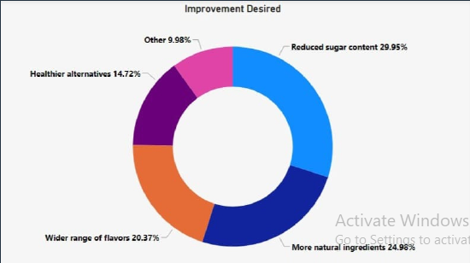
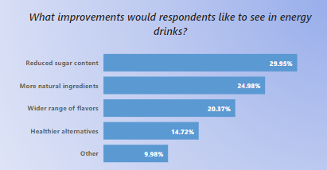

Consumers demand more usage of natural ingredients instead of sugar content may be because of health conciousness.
Some customers also demand a wider range of flavors along with some other healthier alternatives

Slide 12

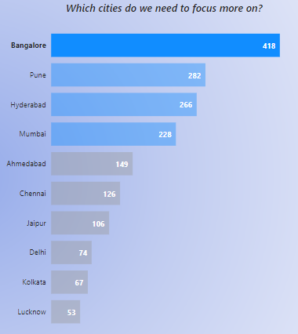
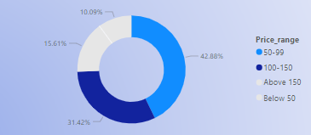

The most preferred price range from the consumers side is 50-99 which means they are more comfortable with this price range.
There are some opportunities available to expand in tier 2 cities such as Lucknow, Jaipur, Ahmedabad, Pune and Kolkata.

Slide 13
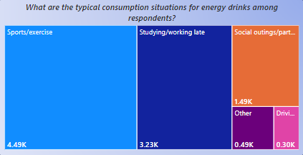
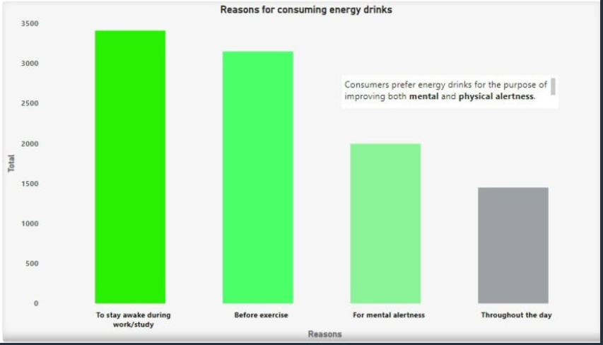

If we talk about the reasons for consuming of energy drinks, we can conclude that mental and physical alertness are the primary reasons for consuming Energy Drinks among all the major users.

Slide 14
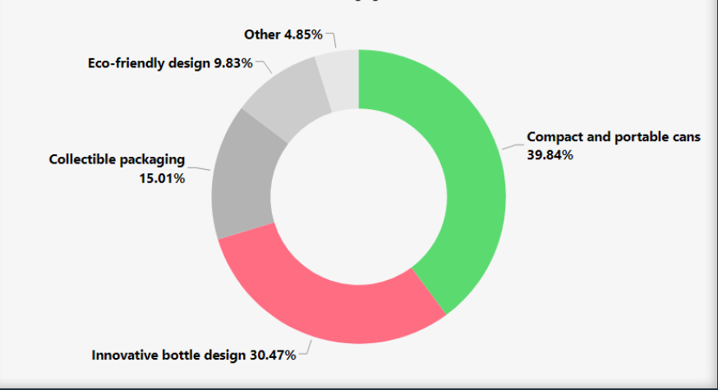
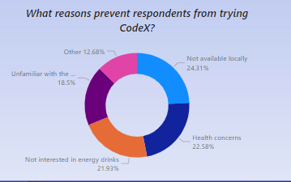
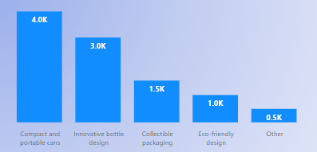
SOME MORE TO GO…

Slide 15
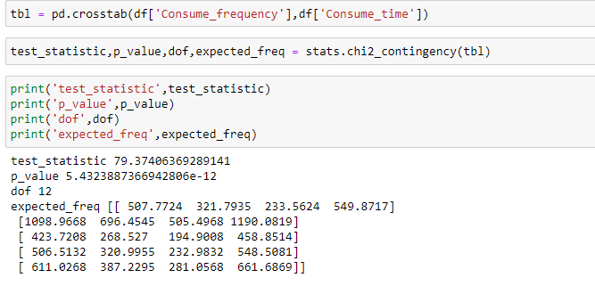

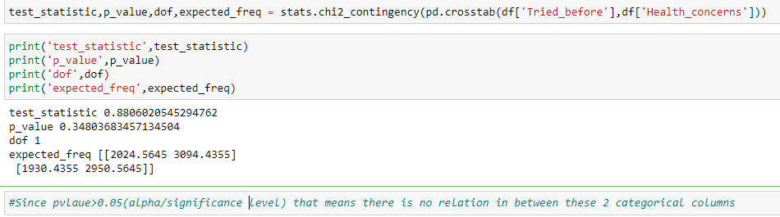
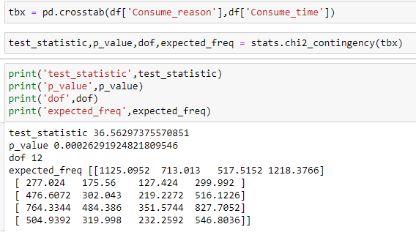

STATISTICAL TEST
Statistical tests have been conducted on various independent variables to understand the relationship in between the categories of the two columns and it is shown most of them have a relation but some variables failed to reject the null hypothesis which means no relation was found in those two columns

Slide 16



AREA TO FOCUS IN BUSINESS
45% of survey respondents attributed non-availability and lack of awareness about CodeX as significant factors.
Given that gyms and fitness centers serve as important venues for sports and exercise and are hotspots for the consumption of energy drinks, there is significant potential to grow branding and marketing initiatives there.
Bangalore, Hyderabad, and Mumbai have a sizable client base, but their citizens are not well-informed about CodeX and its distribution is restricted.
With a large proportion of respondents having negative opinions Hyderabad, Mumbai, and Pune offer a chance to grow their client base by implementing efficient churn control techniques.

Slide 17
The two most desirable changes for energy drinks, according to respondents, are lowering the amount of sugar and adding natural components.
The inclusion of less sugar and more natural ingredients not only improves energy drinks but also expands customer outreach to fitness enthusiasts and sportspersons.
Taste characteristics can be improved by combining vitamins and caffeine in a good ratio to enhance flavor profiles.
There is room for improvement as around 11% of respondents reported a Poor taste experience, highlighting the opportunity to gather feedback and enhance the taste.
Respondents indicate a packaging preference for energy drinks, favoring both compact and portable cans as well as innovative bottle designs, suggesting potential for enhancement in this aspect.

Slide 18

RECOMMENDATIONS FOR BUSINESS USING INSIGHTS
Use of Natural ingredients must be elevated for more business due to consumer preferences such as green tea extract which is rich in antioxidants and has moderate caffeine in it.
Targeting Tier 2 cities lacking brand awareness through a strategic launch marketing campaign.
Usage of the guarana ingredient must be increased as it also comes under natural ingredients and is a good source of sustained energy and mental alertness.
High-impact marketing initiatives, such as supporting regional sporting events or music festivals, might be introduced in Tier 1 cities to build anticipation and buzz for the CodeX brand.

Slide 19

Virat Kohli, M.S. Dhoni, and Neeraj Chopra stand out as the best options for brand ambassadors in the Indian region because of their large fan bases and significant influence in the sports and fitness industries (if a company has a substantial amount of marketing budget).
Capturing and Engaging the attention of the youth demographic (15-30 years) through tailored solutions and services in the product.
Targeting a diverse customer base that includes active individuals in gyms, sports activities, and professionals in some workspaces will surely affect sales in the future.
Giving limited-time discounts and goodies in some major festivals or in some specific seasons. CodeX can offer special discounts like "Summer Special: 25% off" or "Festival Season Discount: Flat 10-15% off."

Slide 20
Thank You!
Sahil Rustagi
Presented By

